Slide 1


IT Transformation:
Out of the Datacenter and
Into the Cloud
Melanie Posey, 451 Research
Jeff Budge, OneNeck IT Solutions
September 12, 2019
Notes:
Title: Hybrid/multicloud: The New Normal for Digital Transformation
Description: In the digital era, the ability to drive innovation, business value, and competitive differentiation is highly IT-dependent and increasingly data-centric. Forward-looking IT leaders are embracing cloud as the deployment approach for IT resources, but migration brings complexity. How are enterprises approaching the many challenges of transformation, which include legacy workload modernization; rationalizing pre-cloud IT infrastructure, determining optimal workload execution venues for enterprise applications, and enabling unified IT/data management? Hybrid/multicloud IT, once an unintended consequence of unchecked technology sprawl, is emerging as a strategic posture to manage the transformation.
In this webinar, Melanie Posey of 451 Research will examine the cloud-driven changes in the enterprise IT landscape and discuss how organizations can achieve agility and flexibility across unified IT environments with the consistency, scale, speed, operational efficiency, and governance required.

Slide 2


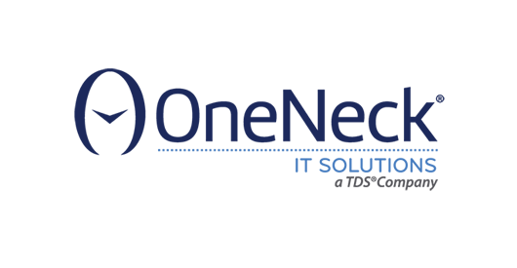

Today’s Speakers
Melanie Posey
Research Vice President
Jeff Budge
VP, Advisory Consulting
Sheryl Kingstone
Research VP & General Manager

Slide 3
Housekeeping Items
Questions?
Questions?
To ask a question, click on the question button
Presentation slides
Presentation Slides
A copy of the presentation slides are located in the resources section for download
On Demand
Feedback
The on demand version of this webcast will be available once the live webcast concludes

Slide 4
Cloud management wheels of fortune
Strategy
Next targets
Cloud
Readiness
Assessment, strategy planning
Migration
Operating model transformation
Integration
Secure landing zones
Notes:
Changes that cloud has been driving in the enterprise IT landscape:
This of this wheel as Day Zero of cloud transformation (some of the WHYs).
If you think about some of the things you need to do to get ready for cloud transformation, it’s kind of like moving a house. When you buy a new house, the last thing you want to do is transport all of the junk from your old house. You want to take with you the things that you need and the things that are going to serve you well in the future.
So, the same thing tends to happen with IT transformation.
So, one of the first things you need to do is assessment, strategy and planning. That give you an idea, or an inventory and discovery to find out what will work in that new house (or in this case cloud).
Then you have to figure out what the operating model transformation will be. One of the key things about this new era of cloud is that IT operates in a very different fashion, so it has to be a different operating model in order to go forward with an agile IT environment to the cloud.
Then like moving a house, you need secure landing zones, you need to figure out where you’re going to put all of your stuff and where it’s going to work best.
And then finally, there’s the integration. How is it all going to work together?
And by the time we get to the migration phase, this is what we tend to call Day 1. Day 1 is moving day, where you get everything into the new house…
And your next job is to figure out what to move next.
This is the cycle of workload transformation. And the way to think about cloud transformation is that it doesn’t happen in one swoop, but one workload at a time.

Slide 5
Cloud management wheels of fortune
Execution
Continuous improvement
Management & Optimization
Transformation
Services
Cost management, resource optimization
Provision, automate, monitor, orchestrate
Self-service catalog, cloud broker
Governance: security, identity, compliance
Notes:
The next cloud wheel of fortune is execution, and execution is all about the Day 2 operations, making everything work together and creating a flexible operating model that covers both the blocking and tackling of IT operations. Things like how do you provision, automate, monitor and orchestrate the IT that runs all of the workloads. And then figuring out the security and governance framework.
This is another area that’s key the idea that cloud is different. Security and governance work very differently in the cloud, and that has to be part of the transformation in both the operating model and the services used to deliver that security.
Then you get into some of the issues around how IT gets delivered, the self-service catalog, the cloud brokerage aspect. It’s the whole transformation that turns IT from an internal cost center to something that’s more like a service bureau or making IT more of a service within the organization.
And then finally there’s the finances. A challenge that a lot of organizations have found with cloud is how do you do cost management and resource optimization? And that is indeed a challenge when you have theoretically unlimited resources that you can spin up in an on-demand basis. You can end up with an interesting budget situation at the end of the quarter. So one of the tasks of cloud execution is making sure that cost optimization happens.
And then it’s all about continuous improvement. You do it all over again for the next set of workloads.

Slide 6
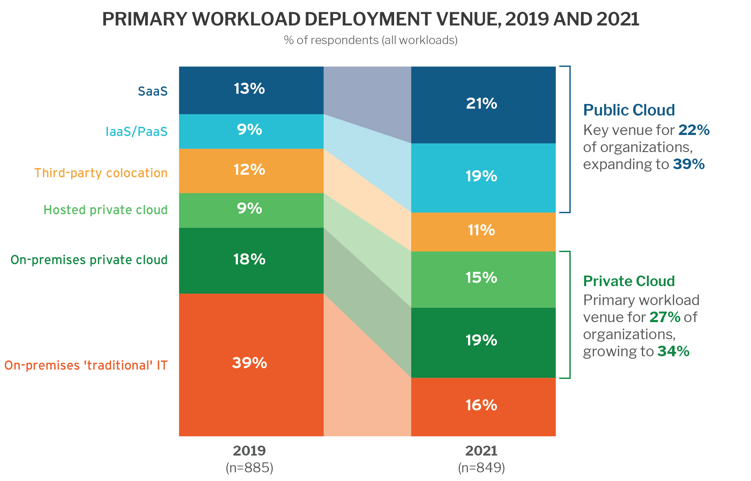
Direction of Workload Travel: Off-premises and to the clouds
Q. Thinking about all of your organization’s workloads/applications, where are the majority of these currently deployed?
Q. And thinking about all of your organization’s workloads/applications, where will the majority of these be deployed two years from now?
Source: Voice of the Enterprise: Digital Pulse, Vendor Evaluations 2018
Notes:
This is 451’s view of the direction of workload travel, and the way things evolving in the enterprise IT space. Workloads are moving off-premises and to the clouds. I say they’re moving to the clouds, instead of moving to the cloud. Imagine me with air quotes with the emphasis on THE CLOUDS. Public cloud and private cloud will play a role in this IT transformation, as will third-party colocation.
The one thing to remember here is there’s not one cloud to rule them all.
If you look at this slide, what you see is that in the 2019 column is the current state of things. We asked our enterprise decision makers panel, where are their current workloads deployed, and where will they be deployed two years from now. What we got in response is that the majority (over half) currently run the majority of their applications in some kind of on-premises environment, whether that’s traditional IT (unvirtualized, bare metal systems, mainframes, etc.) or virtualized systems that aren’t automated or integrated into something resembling an on-premises private cloud.
And what we see 2 years in the future, that there’s still a fair amount of IT on premises, but we see a big growth area for hosted private cloud (9% to 15% over the next 2 years).
Another thing to note is the big increase in public cloud, IaaS and SaaS, but that’s not the entirety of the IT landscape. So public and private are big in the workload deployment mix, which highlights the importance of having a hybrid and multi-cloud strategy, and having a plan in place to support that kind of heterogeneous IT environment.

Slide 7
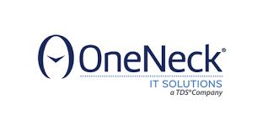


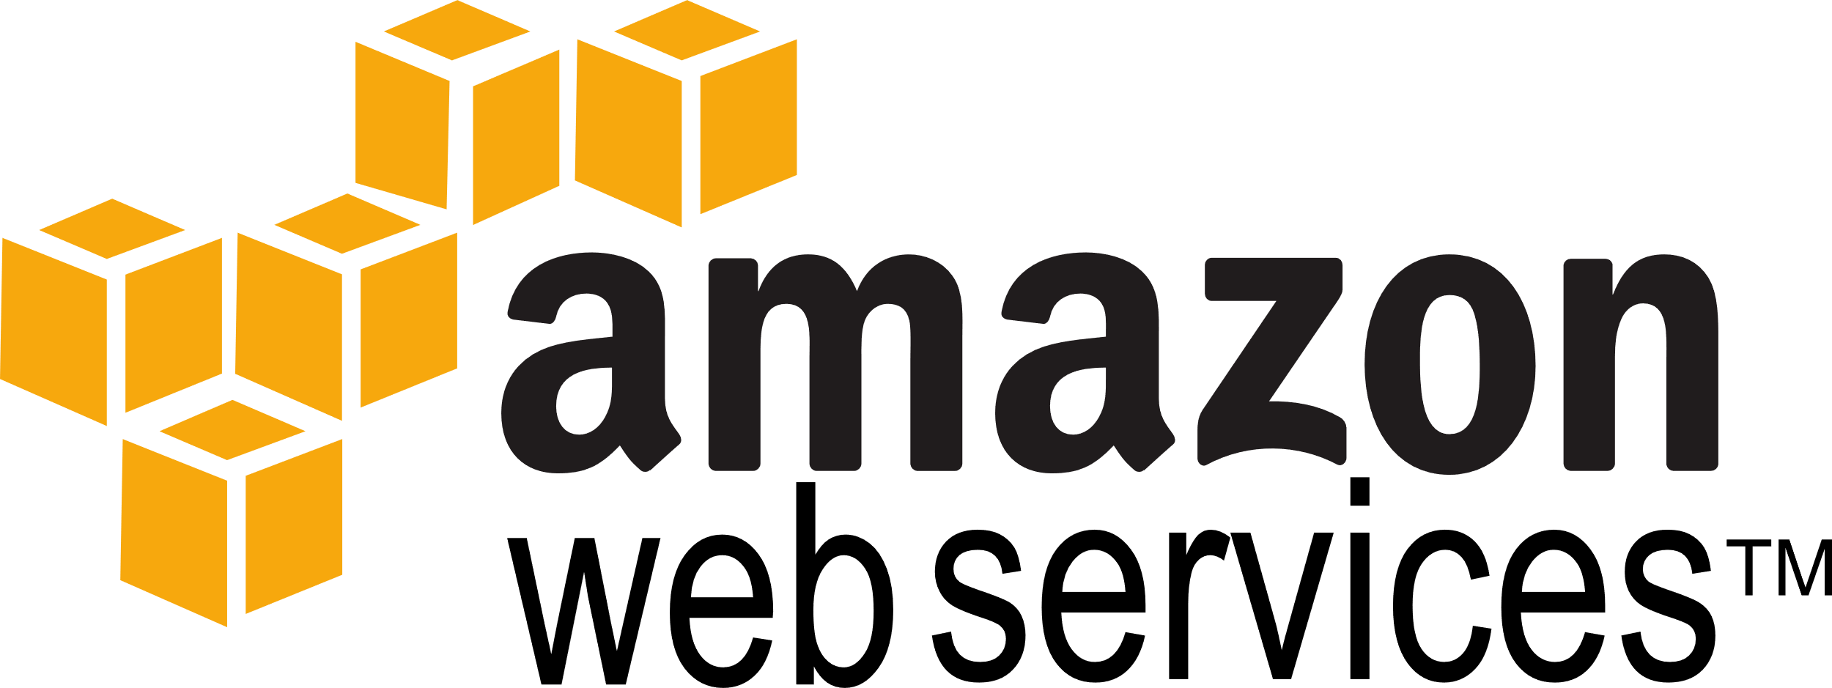
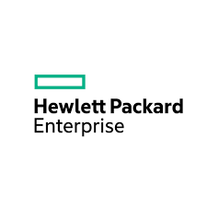

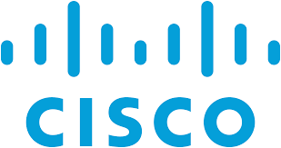
Hybrid IT: From happenstance to strategy
Hosted private
cloud, managed services,
colocation
Hyperscale
IaaS
public cloud
On-premises private cloud
Q. Which of the following best describes your organization's overall IT approach and strategy?
Source: Voice of the Enterprise: Cloud, Hosting & Managed Services, Workloads & Key Projects 2019
Notes:
So, next we’ll talk a little bit about hybrid IT. I titled this slide from happenstance to strategy because it tracks a trajectory we’ve seen from the early days of cloud, when hybrid was something that just happened (primarily as a result of some type of shadow IT where the developers were using off-premises public cloud resources, because they didn’t get the responsiveness they needed from the centralized IT department).
We’ve moved away from this whole idea of shadow IT being this huge problem looming over organizations. We’re now seeing IT departments embrace public cloud, and also embrace hybrid as an explicit IT strategy.
We asked our panel how they would describe their overall organization’s IT strategy, and 57% said hybrid IT environments, where there’s an integrated environment of on-premises and off-premises resources.
And one thing to note here, for all of the talk we heard a few years ago around organizations going all-in to the public cloud, only 19% of organizations take a completely off-premises approach.
And then there’s 10% of the people where cloud is not an important part of their IT strategy. And to some extent, I think business success is not a part of their IT strategy if they’re completely refusing to embrace cloud resources.
If you look on the other side of this slide, I’ve tried to provide a framework on how different vendors operate together in this hybrid, multi-cloud IT future we are seeing going forward.
You’ll still have on-premises resources (primarily private cloud) being used, and you have the range of your usual suspects, your technology vendors who are moving toward that private cloud hyperconverged infrastructure approach.
Then on the other side, you have the hyperscale public cloud players.
And in the middle there’s a huge role for managed services providers like OneNeck, who offer hosted-private cloud, managed services and colocation. It bridges the gap between the on-premises and the off-premises world. One of the most important roles for managed services providers like OneNeck is to provide an alternative location for dedicated private IT resources (private cloud and interconnect to the hyperscale public cloud).

Slide 8
The Case for Hybrid: Flexibility
Q. Which of the following use cases are most important to your organization's use of hybrid/multi-cloud environments?
Source: 451 Research’s Voice of the Enterprise: Cloud, Hosting & Managed Services, Workloads & Key Projects 2019
Notes:
›Next I wanted to show some data about why folks are moving to hybrid IT environments, what some of the use cases are, which we’ve identified within our enterprise IT panel.
One of the big drivers towards hybrid cloud, in the end, it’s all about flexibility. That’s the framework for making sure that the best execution venue for a given workload is covered for today and tomorrow’s needs as well.
One thing that tends to happen in IT is that it never stands still. So, what might have been the best execution venue yesterday might not serve the needs for tomorrow.
The biggest use case that our respondents identified was the need to migrate workloads as needed between on-premises and public cloud environments. The one thing to keep in mind about cloud is that the migration might be a one-time thing (lift and shift, one and done), or it could be a continuous process that an organization might be using to optimize the user experience with the workload, touching on application performance, data residency issues, cost – lots of different issues that might determine if a workload is better suited here or there.
And that’s the flexible workload placement best execution use case demonstrated here.
Then there is also the whole run-anywhere factor. Increasingly, we’re seeing that that’s a big driver for organizations as well. And that comes into play in the 4th from the bottom bar – compatible environments for the development lifecycle. That’s about 24% of people identify that as a key use case. Increasingly we’re seeing this as important, as what a lot of organizations want to be able to do is test/dev, create production staging, and then production in compatible environments across that entire application lifecycle.
If you are an organization and you see applications for any one of these particular use cases across your workload environment, then hybrid is a good choice and a good strategy overall for providing a flexible framework for your IT going forward.

Slide 9

Best execution venue considerations
Which workloads go where?
WORKLOAD LOCATION DRIVERS
% of respondents (n=575)
Q. In general, which factors are most influential when determining the best workload execution venue/location?
Source: Voice of the Enterprise: Cloud, Hosting & Managed Services, Workloads and Key Projects 2019
Notes:
This next slide looks more explicitly at the best execution venue considerations. How do you decide which workload needs to go where? So, to answer this question, we asked our panel about the factors that are most influential in determining workload execution venue or location.
And anytime you ask a survey question related to IT, it comes as no surprise that cost and security end up being the top-rated factors in driving any particular type of behavior.
And then the 3rd and 4th factors here, application performance and platform reliability also play into the notion of where is a workload best situated to operate. It could be the case that it could be cheaper to run in a cloud environment, but it wouldn’t operate very well because it has to interact and draw data from systems somewhere else and latency introduced actually deteriorates the application performance, making the cost savings not even a factor at all.
This is a good way to think about your workloads, in terms of where they should go and where they should run.
For a workload that is non-mission-critical, the cost aspect of that workload might take you to a public cloud environment. But one thing to remember here is that public cloud is not always the cheapest environment. Some of the considerations that have to come in to play are related to existing investments, IT infrastructure on premises, latency considerations, governance and data sovereignty issues might make the choice for you in terms of where the workload has to reside. But this wholistic approach to any best execution venue is one way to ensure that you have an optimized IT environment, that your cost, security and performance are optimized across the range of choices.

Slide 10
IT TRANSFORMATION IS COMPLEX BUT IT’S NOT ABOUT RESOLVING COMPLEXITY
Managed & Professional Services
CONTROL
Unintentional Complexity
CAPABILITY
Willful Complexity
OPTIMIZE THE BALANCE
Notes:
This is a key point to make as far as transformation as a whole. IT transformation is complex. Anytime you’re trying to create a new way of managing and executing applications in your environment, it’s not going to be a simple task.
But the wrong way to think about it is to think how do we resolve this complexity? The complexity isn’t necessarily something to be resolved, because the way we look at this at 451, you end up with a situation of willful complexity completely due to technology innovations.
We have cloud that came along as an option for IT workload executions, and we have cloud-native technologies coming down the pike. There are just a lot more choices for running and optimizing your IT. That’s the willful complexity part of it.
But then there’s the unintentional complexity of all of this IT innovation goodness. How do you control all of it? How do you manage it? And ultimately it comes down to visibility. When you’re able to run multiple workload executions in multiple venues, you need to have control and visibility over all of those things to make sure that governance is in place, application performance is optimized for that particular application, and that security and governance are ensured.
Though the ideal situation is you optimize the balance between capability and control. How do you do this? Is it something that an IT organization has to deal with on its own? You have managed and professional services that can be brought into the mix to help deal with this complexity and optimize the balance between capability and control.
And one reason that bringing managed and professional services into the mix is really important is because our research has show that there is a lack of IT skills related specifically to cloud. Cloud skills always comes up at the top of the list of skills that IT organizations are lacking. Either they don’t have the resources at all or they don’t have enough of them. A lot of these resources have to do with being cloud architects, cloud platform expertise, cloud security expertise and also dev/ops. These are things that are standard IT capabilities, but they need to be relearned and reformatted in cloud environments.

Slide 11
But managed services can help avoid transformation traffic jams
Managed Services Adoption: Today and Two Years from Now
Q. Does your organization currently purchase any of the following types of managed services in connection with cloud?
Q. Does your organization plan to purchase any of the following types of managed services in connection with cloud during the next two years?
Source: Voice of the Enterprise: Cloud, Hosting & Managed Services, Workloads and Key Projects 2019
Notes:
One thing we see here is that managed services can help avoid the roadblocks, get around the traffic jams, that are caused by IT transformation and skills gaps in certain areas. One of the biggest growth areas we see in the coming years is day-to-day operational monitoring, that whole day 2, cloud transformation execution phase of steady-state operations where managing is normal, but with a hybrid IT environment.
Another big area is security for cloud workloads and data, doing that in an on-going basis. As I mentioned, everything happens differently in cloud. So, new services require some new IT skills.
And then optimization of cloud infrastructure is another big area of growth in the next couple of years. Cloud migration and transformation is not a one and done process. It’s a continuous process that managed and professional services can be brought into to help with and help optimize that balance.

Slide 12
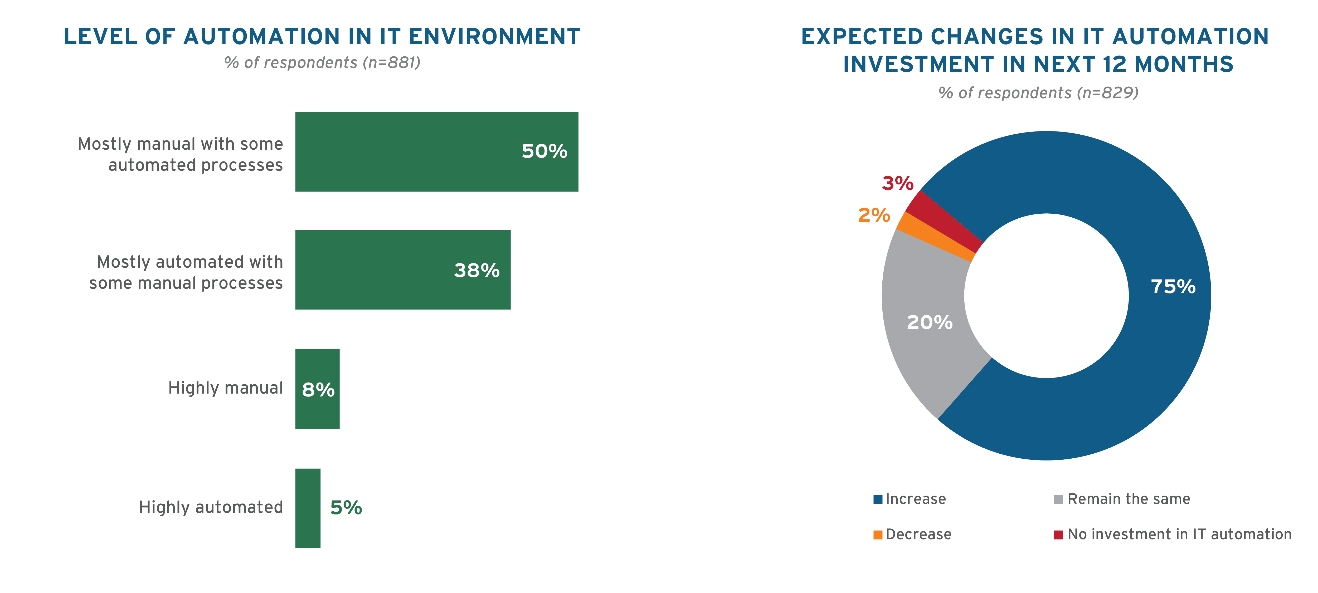
IT environments: Currently more manual than automated
But investment in IT automation is a key priority
Q. How would you describe the current level of automation in your organization's IT environment?
Q. Looking ahead 12 months, how do you expect your organization's investment in IT automation to change?
Source: Voice of the Enterprise: Cloud, Hosting & Managed Services, Workloads & Key Projects 2019
12
Notes:
Another thing that we’re seeing in this space is that IT environments, which are currently quite manual, are moving toward more of an automated foundation. Most companies right now have mostly-manual IT. There’s very little automation in IT environments. But looking forward at where companies are investing, 75% of organizations are planning increases in IT automation over the next 12 months.
Again, this is something that a managed and professional services provider can help with, automating a lot of these processes and bringing in cloud for one vehicle for that automation.

Slide 13
Everyone is at a different
point in the journey
OPS-CENTRIC
DEV-CENTRIC
Cloud-Native, Rebuild
Fully realized self-service environments for developers
Accelerate time to deploy with infrastructure-as-code
Consistent platform for ‘run anywhere’ applications
VALUE
Refactor/Modernize/Re-Platform
Automate IT service provisioning
Eliminate handoffs across teams and tools
Leverage cloud architecture
Enable IT as a service
Rehost/Lift & Shift
Optimize and standardize
Gain visibility into brownfield IT
Right-size clouds
Set policies to address shadow IT
CLOUD ENVIRONMENT MANAGEMENT
CONTAINERS/SERVERLESS
CLOUD INFRASTRUCTURE MANAGEMENT
AGILITY
Notes:
In wrapping up here… one of the key points is that every company is at a different point in their cloud journey. There’s no such thing as a typical cloud journey for any organization.
And the overall direction of travel is from operations-centric (all about the IT ops side of things), to much more developer-centric, more about the applications, where the infrastructure is there to support the applications.
Right now a lot of organizations are in this rehost and lift-and-shift phase. It’s all about doing an inventory of all of the stuff you have in your old house to figure out what makes the most sense to move to the new house. One of the key things in this phase is ensuring you have visibility, ensuring that you right-size your resources properly, and that you have policies in place that address shadow IT by handing over the keys to some extent and allowing end users to resource some of their own IT requirements.
The next phase is refactor, modernize, re-platform. Once you get to the new house, how do you make things work more efficiently? A lot of that has to do with automation of the services provisioning, visibility across the IT landscape to eliminate handoffs across teams and tools, and also being able to leverage cloud architecter in a way that enables business and also enables the IT department to serve as a service provider to the company.
And finally there’s the stage of cloud-native and rebuilding. So, at this phase, what you’ve done is created a consistent platform for run-anywhere type of applications. You have an operational model in place that gives you the flexibility you need to source new capabilities, but also the stability that gives you the visibility to manage, monitor and secure your IT environment. At this stage, we move from cloud infrastructure management to cloud environment management. It combines the applications and the infrastructure, and starts to bring in some cloud-native capabilities like containers and serverless.

Slide 14

Takeaways
Digital transformation (eventually) simplifies IT but complications abound in the short term
There is no “one cloud to rule them all” – flexible IT environments deliver the best value
Heterogeneous IT estates, and application development/runtime environments, and data repositories require unified management and a ‘single version of the truth’
Net-new apps will be ‘cloudy’ by default, giving developers increased influence over where the data needs to reside
Vendors with ‘open’ approaches to data management (and broad partner ecosystems) will be best positioned for growth
Notes:
And to wrap up my piece of things… one of the key take aways is that digital transformation does eventually simplify IT, but complications abound in the short term that don’t so much need to be resolved as the balance needs to be optimized.
And there’s no one cloud to rule them all, but flexible IT environments deliver the best value, and that’s a hybrid IT environment that offers maximum flexibility.
When you have hybrid IT environments, you have applications and runtime environments in different locations and different repositories in different places, you need unified management and a single view of the truth. This all has to happen as an integrated, orchestrated system.
And finally, when you’re looking at vendors to help you get to this hybrid IT nirvana, you need to look at vendors and service providers that have open approaches, that allow for a broad ecosystem of partners to plug in and provide the best opportunities and best optimized cost and resources for optimal growth in a digital transformation world.
And with that, I will pass it off to Jeff.

Slide 15
The Multi-Cloud Journey
Jeff Budge, Advisory
Notes:
Thank you, Melanie.
I wanted to take the time to build upon what Melanie walked through and the concepts she discussed around best execution venue, the different venues in the IT world today, and a bit about that real estate problem that she was talking about, moving from site to site.
As we’ve talked to customers over the past number of years, what we’ve found is that being able to take these complex situations and bring it back to something that they can relate to in their everyday life really helps them understand the strategy that maps along with something they inherently know.

Slide 16

BEV through a Real Estate Lens
On-Premises Legacy = Buy a “traditional” house
On-Premises Private Cloud = Buy a prefab or modular house
Hosted Private Cloud = Live in your parent's house
IaaS = Rent a house
PaaS = Rent a condo/apartment
SaaS = Stay in a hotel/time-share/resort
All of these are good options, choose based on need, preference, timing, cost, etc.
Notes:
So over the last 12-18 months in particular, this discussion around best execution venue, embracing the complexity, finding an approach that leads you through the complexity and allows you to make the right decisions of workload placement into the proper execution venue has been a very crucial part to our customer’s success.
So, one of the talk tracks that I often leverage when we work with our customers is that real estate analogy and best execution venue (that acronym at the top – BEV).
So if you think of the typical execution venues in the market today, you can relate those two real estate concepts that we all know and understand:
Your on premises legacy system is a lot like owning, building or buying a traditional house. It's something that we've all had, we've all lived in, or perhaps we have it in our future of something we would like to do. And we understand that is a place where have a high degree of control, where we are able to choose the finished, the style and so forth of how we want that house to look and operate and support the workloads that we have.
In some cases, we may consider another type of on-prem that might be modular or prefabricated. In a lot of cases, I equate that to a private cloud where you may have a cloud environment that is more tightly integrated, perhaps comes with a set of snap-in services based on the fact that it was a standardized build, if you will. I somewhat jokingly refer to a hosted private cloud as living in your parent’s house. In that case, I’m really just occupying a room, occupying some space within a larger residence that then has services attached to it and the owner of the house is the only one that is driving some of the decisions around services. I’ll come back to that a bit more later to further clarify what I mean.
As we get into the public cloud world, you can see the different options there around infrastructure as a service, similar to renting a house, platform as a service being similar to renting an apartment or a condo, where there’s more services included and are a standardized part of that residence, and I’m just enjoying the features as opposed to having to make any decisions about how to implement the features.
And then at the other end of the spectrum, from the on-prem legacy, buying the house, I think of software as a service as being like staying in a hotel, where it’s all about the features. I’m not making very many decisions about how it was put together or how the services are assembled together. I’m really looking for a specific set of services, features and capabilities, and I just want to leverage them through my my use of it.
So that’s the way I equate all of these different execution venues into different real estate types, and it’s interesting to think of that way because it makes it almost easy to think (or easier) to think about some situations that may or may not make sense. So, for example, would you buy a house for a short-term vacation? Or would you rent a hotel room, or subscribe to a hotel room, to live in for a number of years? Those types of things, just on the surface, become a very easy conversation to say yes or no, and understand the implications of that.

Slide 17

Lifecycle
Regardless of which residence type you choose, you have major lifecycle events that will require you to take care of necessary activity:
Moving = Migration
Unpack = Infrastructure Deployment
Arrange and Decorate = Application Integration
Remodel = Application Modernization
Finance / Refinance / Negotiate = Cost Optimization
Live in it = Operations
Notes:
In addition to the venue itself, we also need to think about some of the different lifecycle activities, lifecycle phases of things that Melanie touched on earlier. And I equate them similarly to parts of the IT world.
So, moving is like migration, unpacking all those boxes is like deploying infrastructure, arranging and decorating the house is integrating where I’m taking my belongings and making them a part of the house and figuring out how they work well together.
Remodeling the house is easily seen to be something like application modernization, negotiation a new rent or refinancing my mortgage is part of the cost optimization.
And then perhaps the one that we (in most cases) are most familiar with, the operation side, when I’m living in a residence that I’ve chosen, when my workload is in a particular execution venue, the day-to-day running, the length of time that I’m leveraging that environment is that live-in and operation state.

Slide 18

Intersecting venue and lifecycle
Each venue has different options for each lifecycle step. The easiest lifecycle step to imagine is Operations. Let’s use lawn care as an example for an operational activity:
  On-Premises - I cut the grass or I hire someone to the cut grass
  Hosted Private Cloud - I can cut grass, help cut grass or not cut grass
  IaaS - I will have to read my contract on who cuts grass
  PaaS - the grass cutting is included
  SaaS - I admire how nice the grass looks
But we all also know that there is much more to operating a residence that just cutting the grass. Each operational activity will have different options per venue (pest control, utilities, internet access, TV service, snow clearing, etc.) leading to complexity.
Notes:
Let’s dive into that operation side and think about what I’m thinking about venues and those features, and then thinking about the lifecycle phases and what that means to my workload, and I break down those lifecycle phases into activities and start to build things like total cost of ownership models, and feature models and do somewhat of that environment comparison to really embrace the complexity and understand all of the underlying details in the complexity to help drive the proper decision for our workloads.
So if I think about one of the operations processes that’s near and dear to my heart, I still am the type of person who cuts my own grass. I own a legacy house. I like to cut my own grass, and it’s a choice that I’ve made. And so when I think of on-premises, some people like to cut their own grass as an operational process. Some people like to outsource the cutting of the grass to perhaps a service agency that will do their lawn service. And hosted private cloud, living in my parent’s house, I might cut the grass, I might choose to cut part of the grass to help them out, or I might ignore cutting the grass and leave it to the owner of the house to determine how the grass is cut.
In infrastructure as a service, and this is something that as you are moving further into the cloud, I would definitely encourage you to understand. You really need to understand in the contract, who has to cut the grass, because with different providers of house renting, or in different service providers of infrastructure as a service, what’s included and what’s not included very much can differ based on the vendor and on the agreement you signed, and at what point in that vendor’s lifecycle you signed an agreement.
With platform as a service, of course the grass cutting is included.
And with software as a service, I just look at the grass. It’s beautiful grass. I love how it looks, and it enhances the features and the enjoyment of me leveraging that venue.
Now I realize this is a bit lighthearted, so I’ll cut to the chase. If you think of all of these things as choices I make on how I procure or consume services related to the venue that I chose, each of those then has a feature set and a cost. And this one grass-cutting activity is just one of the operations activities I need to account for. I need to account for pest control, utilities, Internet access, TV service, snow clearing, all of these things. All of those things feed into the cost basis that I need to consider for this combination of workload and venue.

Slide 19
Total Cost of Each Venue
When choosing the best execution venue for your workload, you must consider all the lifecycle costs, requirements, capabilities, etc. of each venue.
Using our real estate analogy:
  Operational TCO = pest control + lawn care + utilities + snow clearing + …
In execution venues:
  Operational TCO = security + performance monitoring + power + backup + …
  Which items are included or not included in the venue price will differ by venue. This has been hard to accurately quantify as the venue options grow in number and complexity, and this venue decision should be made for each type of application
Notes:
So, if we continue to blow that out in the real estate analogy, the TCO of operations is pest control, plus lawn care, plus utilities, plus snow clearing. In IT terms, that could be security services, plus performance monitoring, plus power, plus backup.
Now think again that we have multiple lifecycle phases, operations, migration, modernization, so on and so forth. Each of those has a level of features and the TCO. And so all of that complexity needs to be brought in, taking into consideration as I’m choosing venues for my particular workloads.

Slide 20

Cost is only one reason to choose.
What other reasons will influence a BEV decision?
C18. Why did your organization migrate applications/workloads from a company-owned datacenter to a colocation provider?
Notes:
Now as you saw in a chart that Melanie shared earlier, costs and security were number one and number two.
We talked about costs. Certainly you can inherently understand that there’s some security aspects to the decisions I need to make. But there’s lots of other reasons. So if costs is only one reason, this chart (also from 451 Research surveys) gives some other common reasons that will influence your best execution venue choice, such as business growth. Perhaps you have data enter assets that you’re consolidating. All of these things need to be brought into consideration.
So where I’m leading with all of this is that there is a lot of complexity and to think of this as being a situation where I have many workloads in my estate, within my overall landscape of a business, I need to have this type of analysis mindset to determine features, venue, services, cost and other other features along the way, and to do that, I really need to a standard approach.

Slide 21
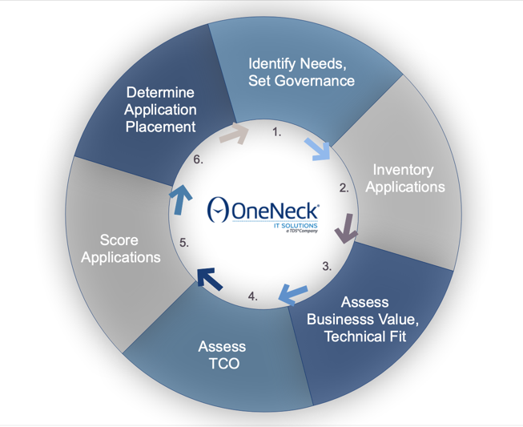
BEV Approach
Notes:
So, this is kind of the OneNeck version of a wheel of fortune. We have our own set here. In this case, this is the approach that we use when we work with customers to help them determine best execution venue across their portfolio of applications.
And a lot of what we’re trying to do here is tackle a lot of the data that I gathered and analyzed, the data that I describing before, identifying needs, setting the governance, understanding the application portfolio I am having to deal with, looking at business value and technical fit, and that very important task of assessing TCO at that detailed and comprehensive layer, then coming up with a scoring methodology to let us figure out not just what applications are the most important for me to make decisions on, but then can those priorities indicate which venues I need to gain better skills in sooner rather than later.
And where do I need to just make my service decisions related to those venues?
From there, I can determine placement of the workload in the venue, and then I continue that circle both through sets of applications and also over time and working through my business.

Slide 22
OneNeck Client Experiences
BEV Insights and Lessons Learned
Notes:
So let me take you through just one example here where we worked with a customer on the best execution venue scenario, where they were influenced by a number of different factors, and just give you a little bit of a case study of what happened and how they made decisions, how a service provider was involved to help them along the way, and a bit of a future view on where their journey will lead them from here.

Slide 23

Multi-Cloud Progression
Food and Beverage Manufacturer
Longtime ERP Application Management customer, primary ERP impacted by software vendor product roadmap leading to SaaS followed by a corporate acquisition
Hosted Private Cloud to Hybrid Cloud while maintaining application management. Future roadmap is SaaS, but not ready yet, remain hybrid
Insights:
  Crawl – Walk – Run across application modules to track with ERP roadmap
  Application Rationalization to navigate acquisition
  ERP limits leverage of scalability, leading to optimization, connectivity, security needs
  Improvement in monitoring vital to success
  Cost optimization key to controlling cost while maintaining performance
Notes:
So, this customer is a food and beverage manufacturer that has a very typical portfolio of applications, and in particular, OneNeck was engaged to help them with the ERP environment. At the time we first worked with that customer, ERP for them was moving from an on-prem environment into a hosted private cloud environment. That was a decision they made more by their gut at the time than perhaps the comprehensive analysis that we’re indicating here is the best approach now.
So at that point in time, we worked with the customer to move their ERP, application manufacturing supply chain planning, finance, inventory, etc., moved it into a hosted private cloud. That hosted private cloud was provided to them in a concierge level of service, meaning that they paid a known fee on a monthly basis and the hosting, the administration, the monitoring, the performance management, the database management, so on and so forth, was an included set of services in that overall hosted private cloud.
That platform has served them very well over time, but one of the influences they had in their business cycles was that the software vendor that creates or develops ERP for them made an announcement that the on-premises, shrink-wrapped version of their ERP was going to be moving out of that type of architecture and into a SaaS architecture, and all customers had a runway of time to understand what that meant to them and to begin the process of migrating their configuration, their data, from the older architecture into a future view of a SaaS architecture.
So the customer engaged us as a provider to help them understand what that announcement meant and to help them plat a long-term roadmap of how they could move from where they were to where the vendor needed them to go. An additional complication was through the middle of this roadmap, which I’ll talk a bit more about in just a second, that company was then acquired by another company, and so they had more influences of different application portfolios, different priorities, different scrutiny on cost, all of the things that needed to be considered as they thought about where is the best place for this ERP to operate and what level of service does this customer need from their providers to make sure their ERP is performing for the business?
So, what this customer chose to do (you’ll see in the first insight on the slide), we helped them work through a crawl, walk, run type of roadmap, where we could say crawling is moving from that initial hosted private cloud. Their next crawling step was, let’s put one module of our ERP into the SaaS environment, into what the future state will be, and integrate it back to the hosted private cloud environment in that hybrid model. So, in that case, they were able to limit what learning curve they needed to accomplish and overcome moving in too fast. They isolated it to a certain module that was relatively isolated and able to operate on its own, and just needed to share data with the rest of the large ERP, and it allowed them to gain more information, gain more knowledge around how SaaS works, what the cost models look like, what time of skillsets they need, and what type of vendor ecosystem they need to support that environment, and on we went.
Their next step beyond that hosted private cloud core with a module out in SaaS, was to pick up the hosted private cloud version of the software and move it into an infrastructure as a service environment. So, we essentially did a lift and shift of shrink-wrapped software from within hosted private cloud, procured a number of the VMs and other capacities within infrastructure as a service, and shifted that application into the public cloud in an IaaS state. That now allowed them to gain more knowledge on what does this now mean to us on how our users access the application, how it integrates to other backends, what the cost of IaaS vs. the SaaS experience they had with that one module would become, so that continued on. So, they had moved into that state of public cloud IaaS resident software that then was connecting to a SaaS residence model. They found a number of interesting things there that you’ll see in the third insight there were actually some limits to scalability. One of the things that people embrace about public cloud is the ability to have a high degree of scalability. The challenge that they had was not whether the public cloud would support that or not, but the ERP and the fact that they’d done a lift and shift of what was an on-prem piece of software into an infrastructure as a service venue, they now had architectural limits on how they could scale how many nodes they could have, how they could share resources across those nodes and keep the ERP functioning at the level they wanted.
That then led us to discussions and work and activity around resource optimization within the public cloud, cost optimization and leveraging the right products and SKUs in the public cloud, network and connectivity between their on-premises customer base, employee base, their IaaS ERP and their SaaS ERP.
So, you’ll see in the last two, one of the key for them was monitoring, getting that single view across all of these venues. So, they have these complex decisions to make, needed to understand the level of services, needed to make sure the performance was visible and understood across of these hybrid venues, and then also that cost optimization was key in both understanding their cost, controlling their costs and making smart decisions as they move forward on what services they procure next.
Their next step is actually to move everything into SaaS. They’re not quote there yet, but a lot of the work that we’ve done together, both to do that crawl-walk-run understanding of the environments, understanding of the complexity of cost, service, so on and so froth, has really helped to prepare them to move forward into a SaaS destination.

Slide 24
Portfolio Advances
A preview of OneNeck offering development
Notes:
So, as you’re working with your service providers, one of the things I would encourage you to do, part of my role here at OneNeck is around portfolio strategy and to help decide and direct where should we put investment as a service provider, to build new services, to meet our customer’s needs as the IT world is evolving? So, as you’re working with your service providers, I’d encourage you to understand these same types of things.

Slide 25
How can OneNeck help customers across these venues?
OneNeck is developing a portfolio of products and services focused on the top 5 BEV factors.
Notes:
One of the first things that we do as we look at the chart that Melanie showed earlier, what are some of the top factors that indicate which venue is chosen? Things like cost, security, performance, reliability, so on and so forth. Your provider should be looking at those factors and figuring out what services can we bring to market that address each of these factors? How can I help my customers understand, bring visibility to and optimize their costs? How can they reduce risk in the security world? How can they predict and control and understand their application performance, so on and so forth? Additionally, beyond just the big factors of cost, security, performance and so forth, when you bring that down to the actual services that the service provider needs to bring to bear, these are the types of things we are commonly then intersecting with those driving factors.

Slide 26
What services are usually purchased in connection with cloud or hosted infrastructure/applications
Q29. Does your organization currently purchase any of the following types of managed services in connection with cloud or hosted infrastructure/applications?
Notes:
Most customers are asking for a certain set of services from their service providers, whether that is monitoring, whether it is application management, optimization and consulting services, backup and DR. All of these type of reasons then need to be intersected with that cost, security, performance and reliability set of driving factors to come up with the right portfolio, in the right venues, with the right level of services as the menu of options to meet the customer’s needs. And that is really where OneNeck has arrived.

Slide 27

Reduce the Complexity
Currently available products and services:
Remote On-premises Managed Services = packaged pricing for a set of services
ReliaCloud = concierge-style services accompanying hosted private cloud
Azure Managed Services = managed services on top of Azure
Multi-Cloud Strategy = application portfolio analysis and road mapping
Cloud Cost Optimization = visibility, analysis and consulting on the cost of public cloud
Notes:
We look at these different services we have in our portfolio, we (in a lot of cases) will arrange them by the type of venue that is in play, and then we’ll describe a set of services.
So, these are just some examples in an on-premises world, and a lot of cases will do remote managed services in a hosted private cloud venue, which our product name is ReliaCloud. In that case, we include a lot of services in a concierge style so that we’re providing a known quality of service, a known amount of visibility within that hosted private cloud venue.
In the public cloud, like in something like Microsoft Azure, you’re looking here for your provider to help you with managing those environments. Since Microsoft or Amazon or Google or someone like that is providing the actual underlying capacity, you need somebody to help you manage that environment.
In addition to that, those last two is more of the consulting side of the world, helping you with strategy and approach to understand and embrace the complexity, helping you with roadmapping, portfolio analysis and also that very quickly growing, very popular service is around cloud cost optimization, understanding what the costs are in public cloud, understanding the bills and how you optimize those environments.

Slide 28

Future Offerings
Application Performance Monitoring next-gen
Data Classification
PaaS / SaaS security and risk management
PaaS / SaaS cost optimization
Public sector-focused cloud services (Azure Government)
Hosted private cloud next-gen (ReliaCloud Gen 3)
Multi-cloud governance
IoT management / Edge computing platforms
Notes:
And then over time, you should see your service providers improving their service offerings, attacking application performance, attacking platforms of service and software as a service both in a cost and a risk management perspective, looking at vertical industry alignment to their services. So again, they’re meeting you with your business needs, your venue choices, your service needs and meeting into those different complexities of cost and workload placement decisions.
So, those are just some of the things that we are helping a lot of our customers with today, and a bit of a view on how both we are evolving our service offerings and how I would recommend you work with your service providers. Ask them what they’re doing to improve and enhance their portfolios to help support and meet your business needs.
So, now I’m going to pass this back to Kristen, as I believe we have some questions in the queue.

Slide 29
THANK YOU

Slide 30

Q & A
Notes:
Q1. Is there any research on how the costs have shifted when going into the cloud? For example, from capital to expense bandwidth?
A1. Melanie Posey: One thing we’ve seen in our cloud economics research, which is call 451 Cloud Price Index, is that depending on the application and the use case, a lot of times bandwidth can actually be your biggest expense when you move applications and workloads to a cloud environment. One things we’ve seen is how colocation can play a role in mitigating some of that bandwidth expense by using managed cloud services and colocating your workload environment in a 3rd-party datacenter that also has direct connectivity to the cloud service providers. In some ways, you can shift that bandwidth expense equation onto interconnection costs as opposed to straight bandwidth costs paid directly to Azure or AWS.
Q2. What comprises the hosted private cloud?
A2. Jeff Budge: Maybe I should take that. So, in hosted private cloud, what we commonly see, and I’ll talk about a couple generations because we’re actually seeing some new advances and new platforms come out in the hosted private cloud market. Traditionally, hosted private cloud would look like, or be made up of, a converged infrastructure platform that was resident in either a service provider’s data center or perhaps colocated in one of their partner’s data center. And you would normally consume hosted private cloud, similar to the way that you would consume infrastructure as a service from the current hyperscale public cloud providers. There, of course, are many different ways it could be consumed. For example, in the way that ReliaCloud was presented to that customer that I described earlier, hosted private cloud was included in their overall application management engagement, so we worked with them to understand what application they needed, then architected pieces of the hosted private cloud to support it, and then that was all provided to them as a single set of services, if you will. But, in most cases, the generic view of hosted private cloud, you’ll consume it in an infrastructure as a service way where you can purchase VMs, you might be able to directly access their storage, maybe able to leverage it as a backup or DR type of destination, many different permeations of that in most cases. They were based on one of the major hypervisors, either VMware or Hyper-V, or perhaps Oracle VM were some of the ones that we commonly see or have used in the past on our hosted private cloud.
What’s coming up next is with the generation of hyperconverged infrastructure in the market, and the maturity that it has achieved, we’re starting to see many service providers move from their prior generation of converged infrastructure-based hosted private cloud, where it really was about the infrastructure, and moving into hyperconverged environments where it’s really about software and services. And so you’ll begin to see more and more providers providing hosted private cloud that looks and feels more like, perhaps the platforms of service offerings that are coming from the likes of AWS and Azure, where you’re able to not just buy infrastructure capacity, but perhaps subscribe to a service such as a platform database, maybe multi-factor authentication. And those will be provided to you more at a service level and behind the scenes, that will all drive a set of software-defined infrastructure, networking, security, connectivity, capacity, so on and so forth. Hopefully that answers the question. Melanie, additional thoughts?
Melanie Posey: I’d just reiterate the point that I showed in my part of the presentation is that hosted private cloud is increasingly becoming a popular execution venue for workloads. And the thing to remember with hosted private cloud is that sometimes you do have workloads that require dedicated capacity that’s not delivered on a shared-tenant basis. So, one way to think about your workload estate is to think about workloads that have pretty steady state, well-defined capacity requirements, and consider those perhaps as candidates for hosted private cloud, whereas workloads with more volatile capacity requirements and peak loads, maybe consider those more of a candidate for public infrastructure as a service cloud offering.
Q3. Does OneNeck offer the V Center, access-based HTC?
A3. Jeff Budge: I was actually just typing up an answer in the Q&A block to that question, as it’s a bit of a maybe/it-depends answer. So, the question I have on this is, when we say V Center access-based, I’m not sure what level of access or integration to V Center is needed. In this case, I will say that from a hosted private cloud perspective, products that OneNeck has in market today and will in the future, there is a number of service offerings that are VMware based, where V Center is a part of the infrastructure. But I would need to know more about when you say V Center access based, what level of access the end customers would need to the V Center, what type of integration they would need to their VMware environment, so on and so forth. But I’d say that there’s definitely a possibility we have a match there, but just need more details on exactly what level of integration and what level of access would be needed there. So, perhaps we can follow up in person.

Slide 31
Thank you

